Slide 1


Healthy Lifestyles
0-19 Public Health Nursing Service
School Nurses

Slide 2


What do the school nurses do?
We work closely with schools to identify children that might need our help.
We support children, young people and their families around:
Physical, Social & Emotional health
The school nurse team is made up of specialist public health nurses, nurses, and healthcare support workers.
Notes:
We work in partnership with children, young people and their families to ensure that all health needs are being supported in the community.
We cover all of north Hampshire schools and work closely with other agencies such as Education, social care and other health professionals including:
- GP’s
- Dentists
- Physios
- Counselling services
- Diabetic nurses
- Asthma nurses
- Epilepsy nurses

Slide 3



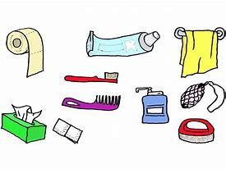


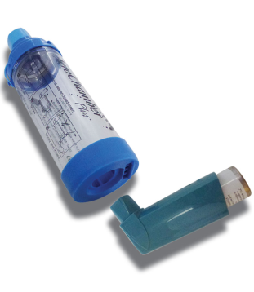
Physical
Sleep
Body image
Nutrition
Dental care
Hygiene
Exercise
Puberty & Body changes
Injuries
Health conditions
Notes:
Elaborate on importance of each element.
Sleep – getting enough sleep, not having blue light / phones / screen time, taking time to relax, routine and going to be at the same time every night
Nutrition – food from each of the 5 food groups, 5 pieces of fruit and veg a day, sugar swaps, change for life initiative
Changes to your body – puberty, hair in places where it wasn’t before, checking breasts and testicles
Hygiene – washing daily, clean clothes
Health conditions – asthma, diabetes, epilepsy etc. ensuring reviews and
Injuries – its normal to get injured, when to seek medical attention and how
Body image – media has caused different perception of the body, how we see ourselves and how we feel in our own skin
Dental – brushing teeth twice a day and gums and tongue, seeing the dentist 6monthly - yearly

Slide 4


Emotional Wellbeing
Emotionally healthy people can still feel anxious, stressed, angry and sad at times, but they are able to manage their negative feelings.
Emotions clip
Things that affect our emotions include:
Friendships
&
Relationships
Change
School
Exam stress
Sleep problems
New
Environment
Notes:
Its completely normal to experience challenges with our emotions, however when you combine this with pressures they are often harder to manage.
Its about trying to find the balance to be able to deal with these things without it effecting your health and wellbeing.
You can:
Talk to someone you trust
Practice breathing techniques
Access support in school or out of school
Ask for help

Slide 5

Anxiety or Worry
‘Anxiety’ is a word we use to describe feelings of worry, fear and panic.
It is a normal response to feeling threatened or in danger this could be real or imagined.
Anxiety might cause physical symptoms such as a racing heart, breathing fast, sweaty hands, dry mouth and feeling shaky.
Notes:
You can be anxious without having anxiety.
Being anxious is when you are in a stressful situation, but is usually short lived and can be resolved.
Having anxiety in the long term, can affect your everyday life. Take steps to manage Anxiety, seek support.

Slide 6

Managing your worries
Take time out – Relax and enjoy your hobbies
Limiting caffeine intake – tea, coffee, fizzy or energy drinks
Get enough sleep!
Exercise daily to help yourself feel good
Take slow…deep…breaths
Eat well-balanced meals

Slide 7
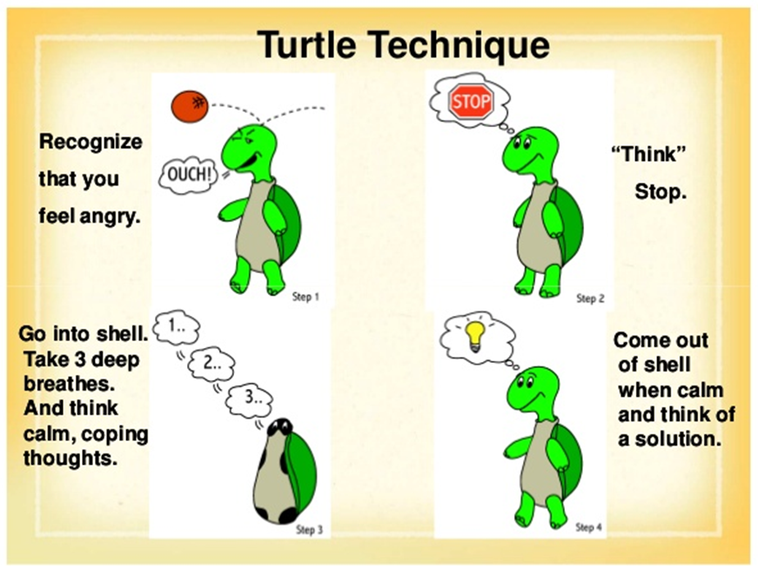
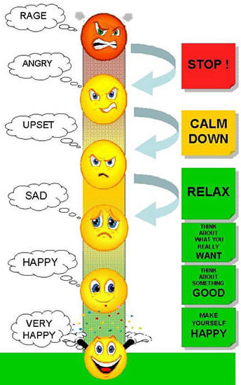
Feeling Angry?
Anger is a normal emotion but it is one that can affect our self- esteem, friendships and relationships.
Notes:
Consider ways that you can manage your anger.

Slide 8
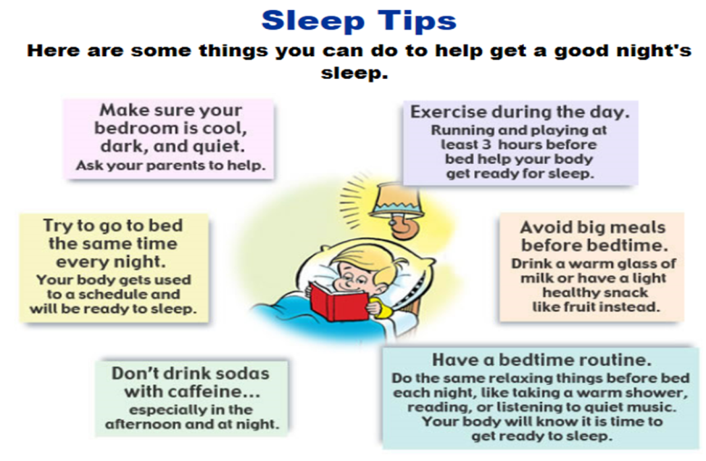
The Importance of Sleep
Children aged 6-12 years old need 9-12 hours of sleep
every 24 hours.
Notes:
You can be anxious without having anxiety.
Being anxious is when you are in a stressful situation, but is usually short lived and can be resolved.
Having anxiety in the long term, can affect your everyday life. Take steps to manage Anxiety, seek support.

Slide 9

Social
Social health is:
How you get along with other people,
How other people react to you
How you interact within society.
Notes:
This would involve:
Family relationships
Friendships
Relationships
Confidence
Communication skills
Interaction within the local community

Slide 10
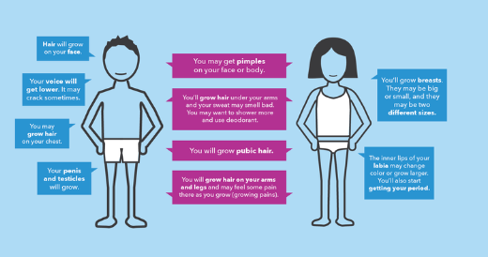
Body changes during puberty
Puberty is controlled by hormones, and these hormones affect your feelings as well as your body. Taking care of your emotions during this time is very important.
There are many body changes that are similar for boys and girls.
Skin changes can cause hair to become greasy and pimples develop on the face or body.
Pubic hair growth happens for both including hair around genitals and hair under armpits. Boys may also grow hair on their face and chest.
Girls will also start getting their periods.
Notes:
So many similarities You may get acne on your face and body. If pimples are stressing you out or causing problems in your life, talk to a doctor.
You start to sweat more, and you may have body odour (when your sweat smells bad). You may want to shower more and start using deodorant.
Hair grows under your armpits.
Hair grows around your genitals — this is called pubic hair.
You may grow more hair on your arms and legs, and the hair may get darker.
You may feel some pain in your arms and legs as you grow (AKA “growing pains”)
As well as many differences: Males:
Your voice gets lower or deeper. It may crack sometimes while it’s changing, but that’s totally normal and eventually goes away. Your Adam’s apple (bump in your throat) might get bigger and more visible as this happens.
Your penis and testicles get bigger.
Hair may grow on your face, chest, and back.
Your chest and shoulders get broader.
You may have swelling around your nipples during puberty. This can look like the start of breasts, but it usually goes away. This happens to about half of males, and it can last for a few months or up to a few years.
Females:
Your breasts develop and get bigger.
Your hips get wider and your body may become more curvy.
You start getting your period.
Your labia may change color and grow bigger.

Slide 11

Managing periods
Girls may like to have a small ‘wash bag’ in their school bag. This should contain spare underwear and sanitary pads.
Schools all have free sanitary provisions available.
Being prepared will help to
reduce worry for young girls.

Slide 12
What can school nurses help with ?
Emotions
Anxiety
Health concerns
Sleeping problems
Body
Changes
Family
separation
Self Image
Notes:
If you are unsure if the school nurses can help do not be afraid to ask as if we are unable to support or help you we will be able to point you in the direction of who can help.

Slide 13






Book recommendations
There are many books available and they can be a great supportive resource.

Slide 14

Contact a School Nurse
Telephone: 01983 821388
Ask a member of school staff to contact the school nurse team on your behalf.
We go in to High Schools regularly and the student support team will arrange appointments for us to meet you.
Notes:
Its completely normal to experience challenges with our emotions, however when you combine this with pressures they are often harder to manage.
Its about trying to find the balance to be able to deal with these things without it effecting your health and wellbeing.
You can:
Talk to someone you trust
Practice breathing techniques
Access support in school or out of school
Ask for help

