Slide 1
Healthy Lunchbox

Slide 2
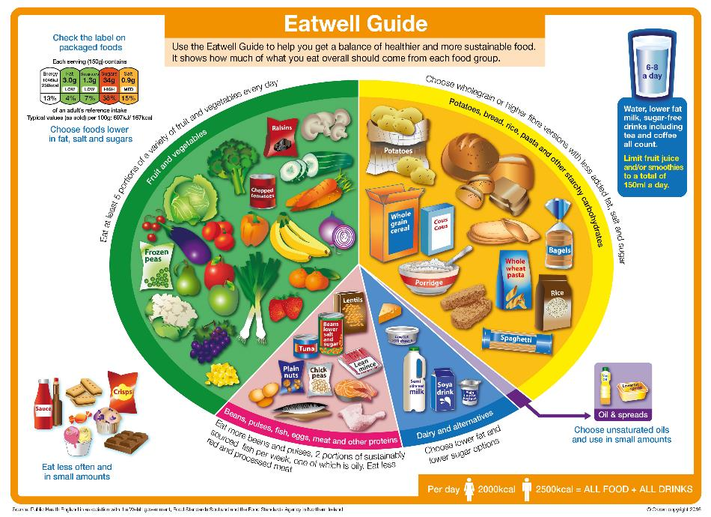
The Eatwell guide
A healthy, balanced lunchbox should be based on the principles of the Eatwell Guide, the UK’s healthy eating model. The Guide shows the proportions in which different types of foods are need to have a well-balanced and healthy diet.
The Eatwell Guide applies to all children from the age of five.

Slide 3



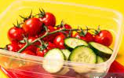
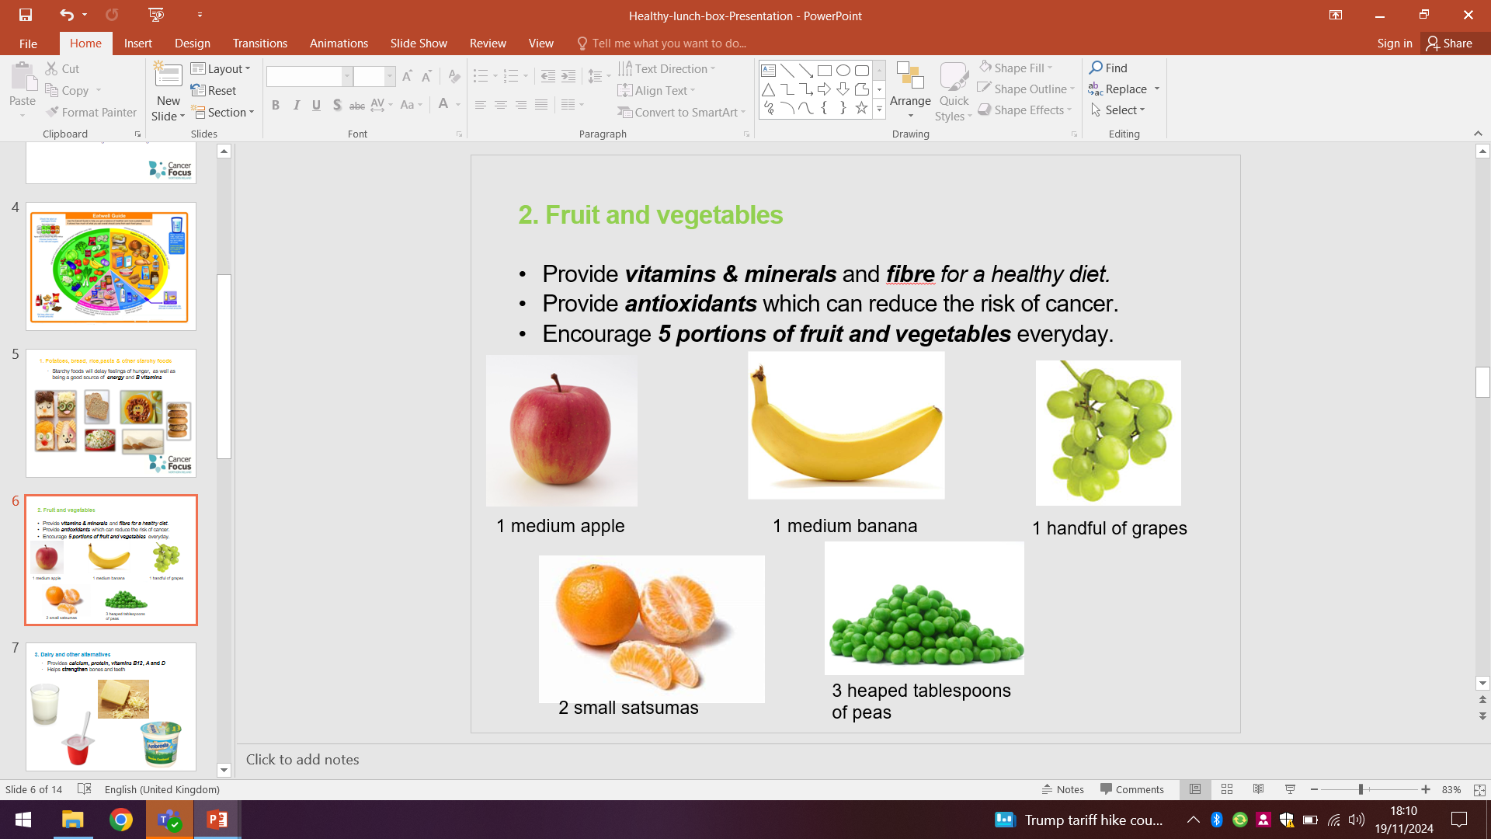

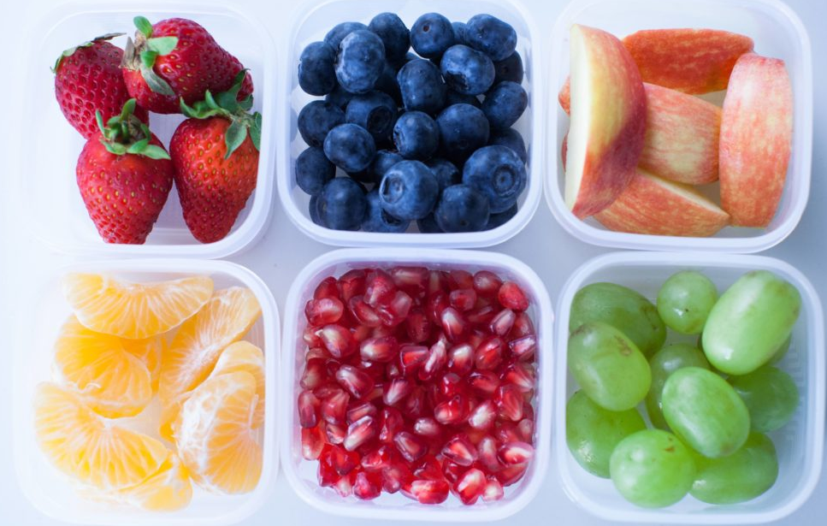
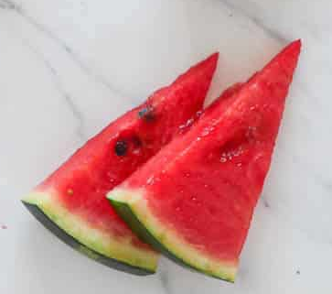
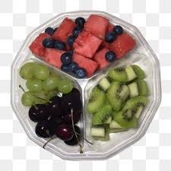

Breaktime snacks
You can no longer bring dried fruit as a breaktime snack as they are high in sugar and can be harmful to teeth.
Also the only snack allowed at breaktimes, due to their healthy properties will now be
FRESH FRUIT OR VEGETABLES.
No fruit winders, fruit bars, yoghurt covered raisins etc. These can be eaten at lunchtime as part of a healthy lunchbox.
Reception and Key Stage 1 pupils have a piece of fruit provided by the Government scheme.

Slide 4

What should a healthy lunchbox look like?
A healthy, balanced lunchbox should be based on the principles of the Eatwell Guide and should include:
Starchy carbohydrates, e.g. potatoes, bread, rice and pasta - choose wholegrain or higher fibre versions when possible!
Plenty of fruit and vegetables – aim for a variety!
A portion of beans, pulses, fish, eggs, meat and other proteins.
A dairy food or calcium fortified dairy alternative.
A drink, e.g. water semi-skimmed milk or 1% milk.
A small amount of unsaturated oils and spreads (if included).
✔
✔
✔
✔
✔
✔

Slide 5
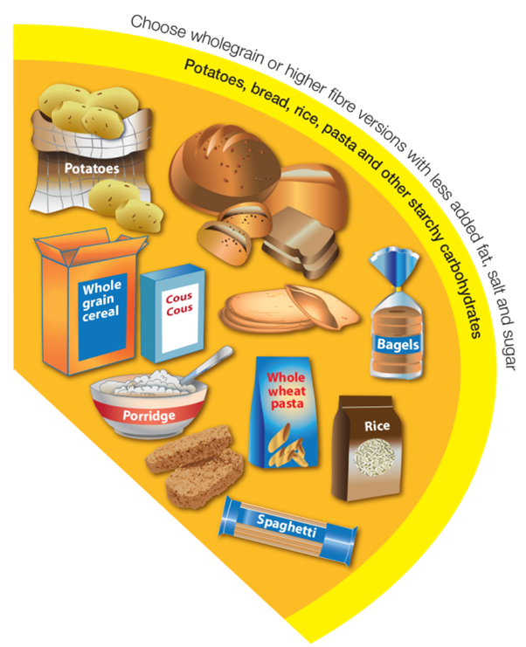
Potatoes, bread, rice, pasta and other starchy carbohydrates
A healthy, balanced lunchbox should be based on starchy carbohydrates, preferably wholegrain to increase fibre.

Slide 6

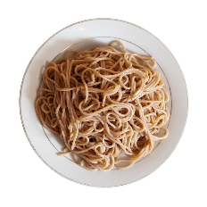
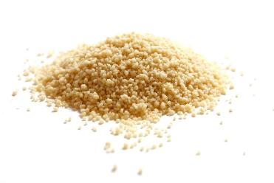



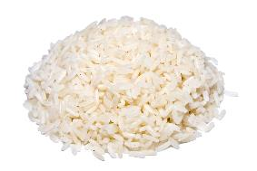

Potatoes, bread, rice, pasta and other starchy carbohydrates
Examples of starchy carbohydrates that can be included in the lunchbox:
wholemeal bread
pasta
couscous
pitta
baked potato with skin
tortilla wrap
chapatti
rice

Slide 7
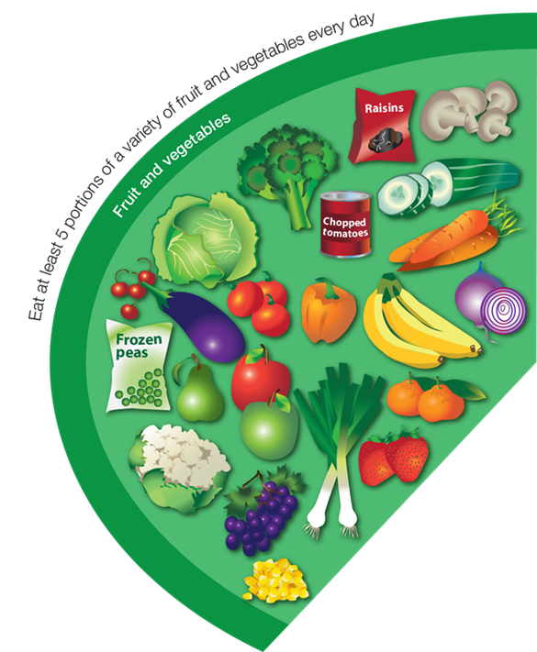
Fruit and vegetables
Include plenty of vegetables and fruit in the lunchbox – at least 1-2 portions!
Aim for a variety of colours !
Fresh, frozen, canned and dried – all count!

Slide 8


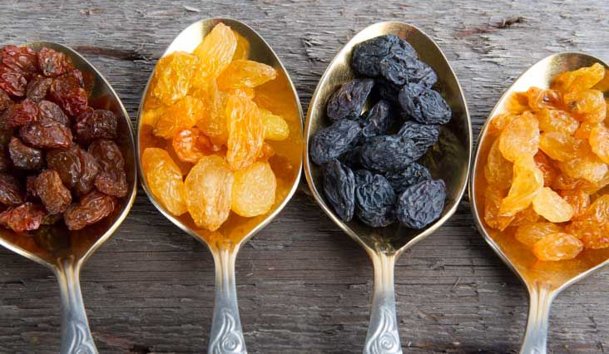



Fruit and vegetables
You could add sliced vegetables into a sandwich, rice or pasta dish.
You could include vegetables for dipping with a small pot of reduced fat hummus.
Dried fruit counts towards your 5 A DAY, but can stick to teeth so should only be eaten at mealtimes to stop them sticking to your teeth.

Slide 9
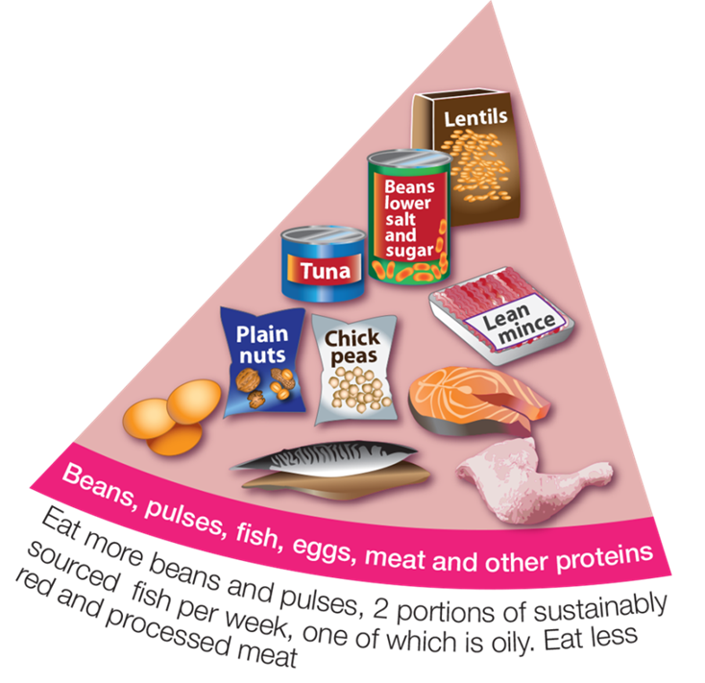
Beans, pulses, fish, eggs, meat and other proteins
Include a portion of beans, pulses, fish, eggs, meat, a dairy food for protein. These foods are good sources of protein, vitamins and minerals.
NO NUTS please in school.

Slide 10

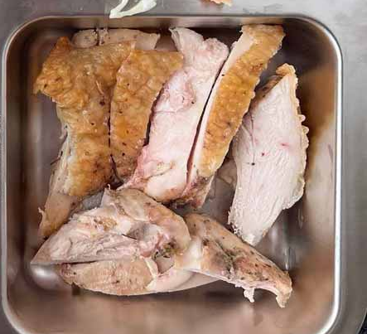
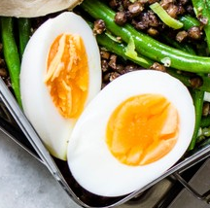



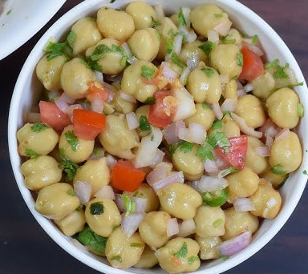
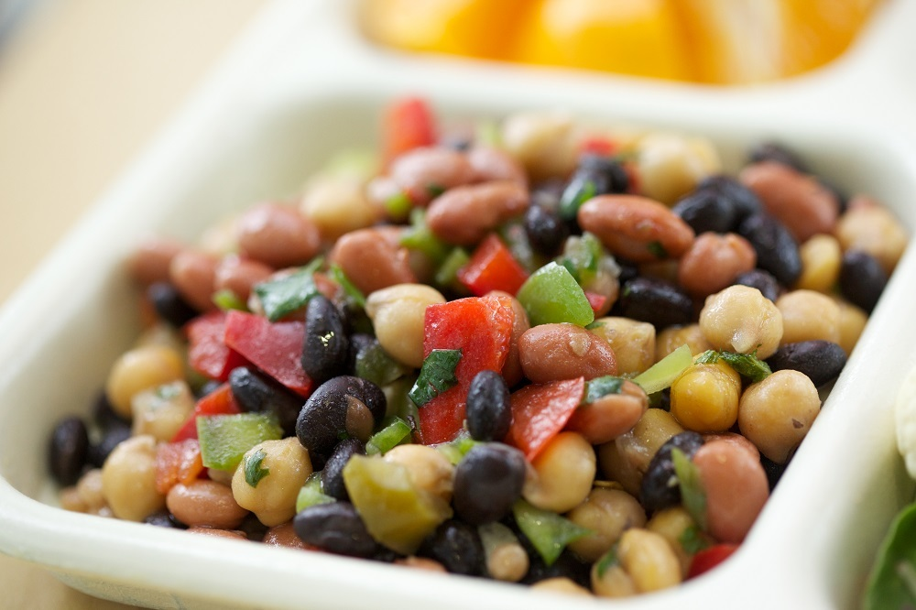
Beans, pulses, fish, eggs, meat and other proteins
Use beans, pulses, fish, eggs, meat and other sources of protein as sandwich fillings or in a pasta or rice salad.

Slide 11
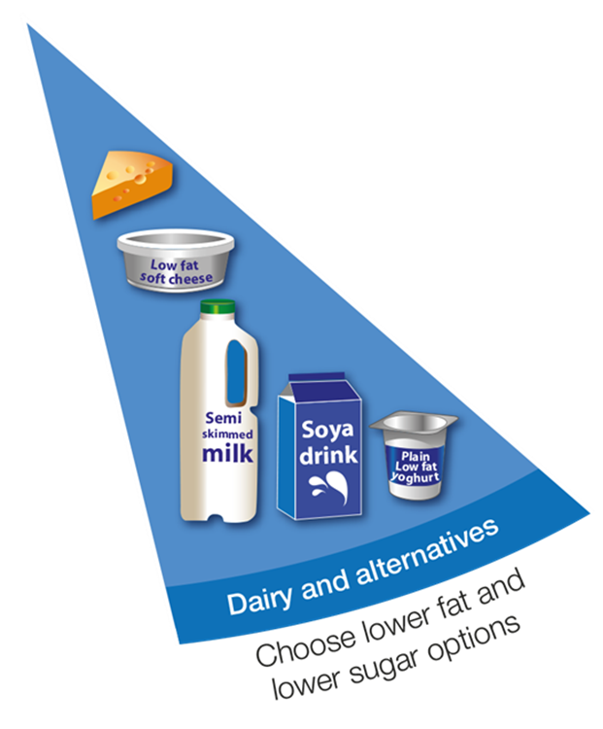
Dairy and alternatives
Add a dairy food or dairy alternative to the lunchbox.
These foods are an important source of calcium, protein and iodine.
Good for growing bones and strong teeth.

Slide 12






Dairy and alternatives
If you’re not including a dairy food in the main lunch item (e.g. in a salad or sandwich), add a yogurt or a portion of cheese such as a stick of Cheddar cheese or cheese triangle to the lunchbox.
Also we have milk at school for pupils to drink at lunchtime.

Slide 13


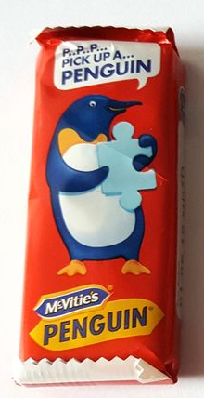



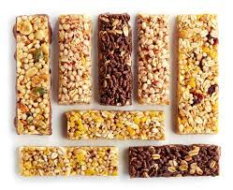





Healthier “treat” alternatives
A healthy lunchbox can include other food.
Treat foods need to be varied and not always the same foods.
This “treat” should only be small compared to other items and will be sent home if too big or too unhealthy.
CHOCOLATE or LARGE CHOCOLATE BARS NOT ALLOWED!

Slide 14

Drinks
A packed lunch should include a drink.
Healthy options include water, semi-skimmed or 1% milk.
You could also give your child fruit juice or smoothie – but remember, fruit juice and smoothies should be limited to a combined total of 150ml a day.

Slide 15
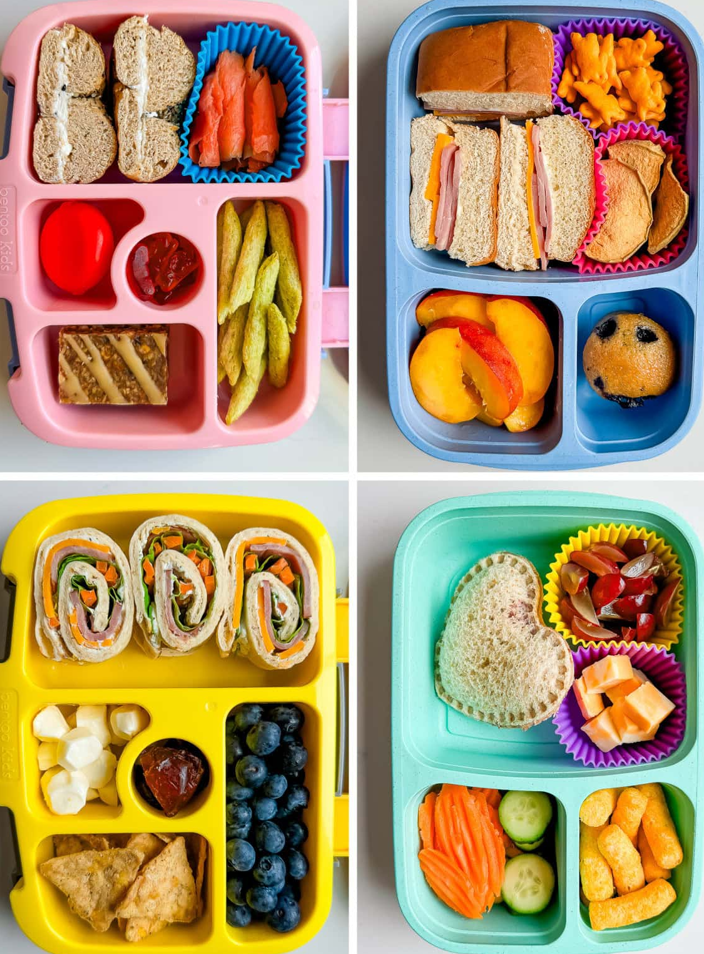

Ideas of a whole lunchbox

Slide 16
Summary
A healthy, balanced lunchbox should include:
Starchy carbohydrates, e.g. potatoes, bread, rice and pasta - choose wholegrain or higher fibre versions when possible!
Plenty of fruit and vegetables – aim for a variety!
A portion of beans, pulses, fish, eggs, meat and other proteins.
A dairy food or calcium fortified dairy alternative.
A drink, e.g. water semi-skimmed milk or 1% milk.
A small amount of unsaturated oils and spreads (if included).
✔
✔
✔
✔
✔
✔

Slide 17
Healthy lunchbox
For further information, go to:
www.nutrition.org.uk
Or
https://www.doverpark.co.uk/school-dinner-menu-food-policy-snacks-and-packed-l/

